Slide 1
Effects of the Black Death — source response
Year 8 Australian Curriculum History
© The State of Queensland (Queensland Studies Authority) and its licensors 2012. All web links correct at time of publication. Image: Sarlat - Passage - Shoes on Wires, Justus Hayes, Creative Commons Attribution 2.0, www.flickr.com/photos/shoes_on_wires/2339951157

Slide 2
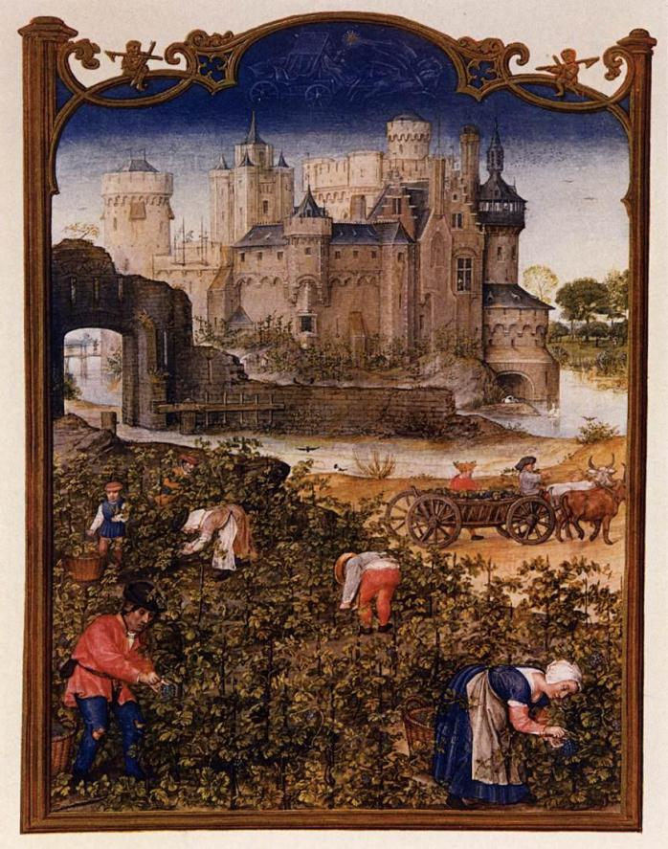
Source A
Source A is an illustration from the Grimani Breviary.
This was a document created in the 14th century and gave information about the types of plants and farming to be done during the year.
This illustration is for the month of September.
Image: Grimani Breviary: The Month of September, artist unknown Public domain image www.commons.wikimedia.org/wiki/File:15th-century_unknown_painters_-_Grimani_Breviary_-_The_Month_of_September_-_WGA15783.jpg

Slide 3
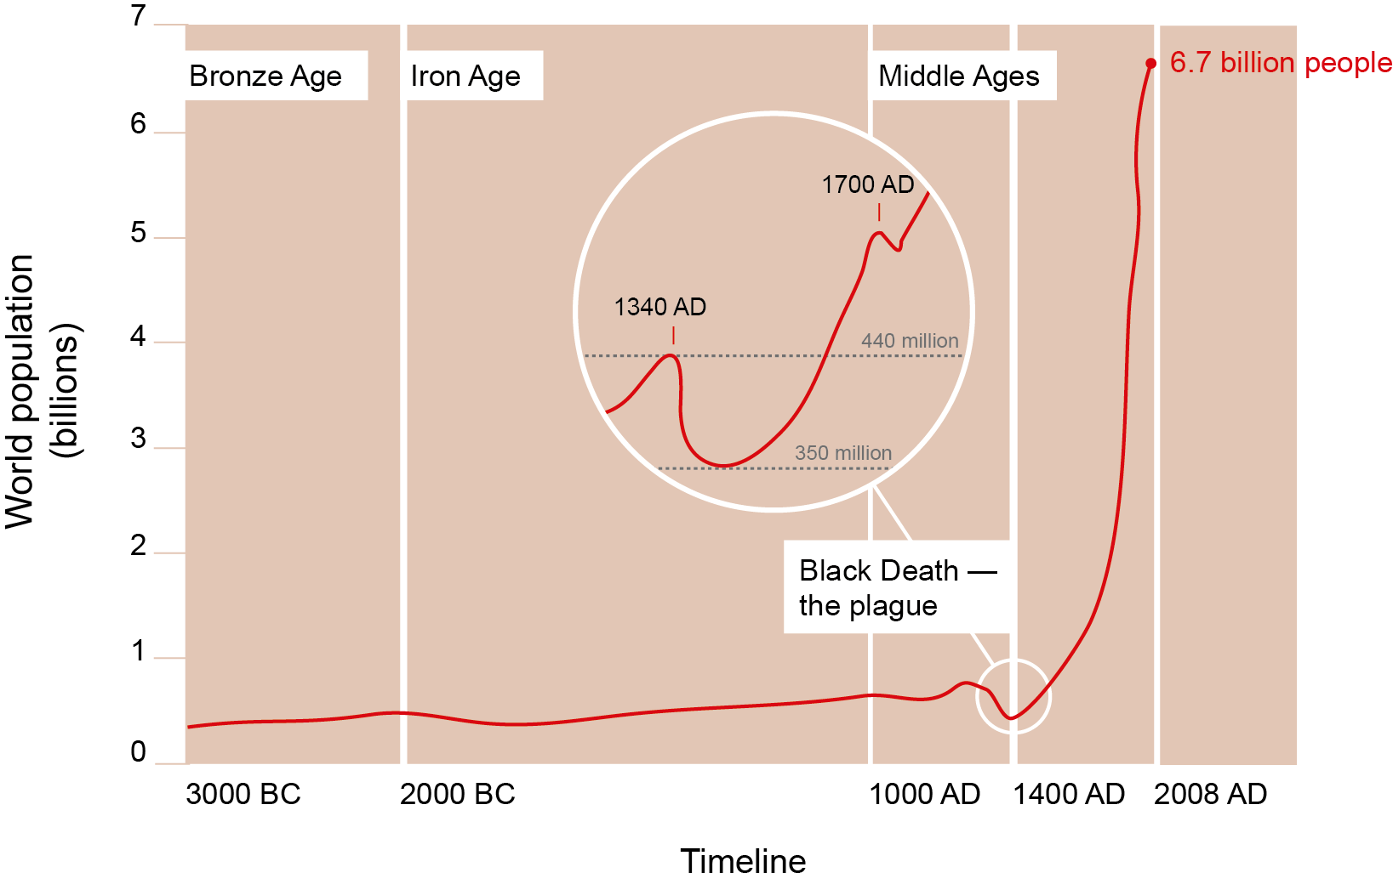
Source B
Source B is a secondary source that shows world population growth throughout history. Historians have different opinions on exactly how many people died as a result of the Black Death.

Slide 4

Source C
In Source C Matteo Villani, who lived in Florence (Italy) during the time of the plague, describes what life was like during and after the Black Death.
“Men dreamed of wealth and abundance in garments and in all other things . . . beyond meat and drink; yet, in fact, things turned out widely different; for most [luxury] commodities were more costly, by twice or more, than before the plague. And the price of labour, and the work of all trades and crafts, rose in disorderly fashion beyond the double.”
Image:Old Paper - Single, bittbox, Creative Commons Attribution 2.0, www.flickr.com/photos/bittbox/2691975784

Slide 5
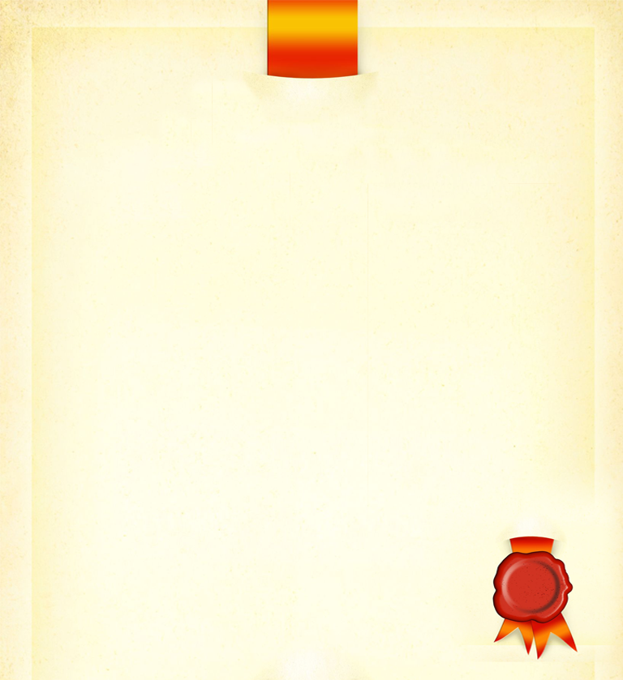

Source D
Source D is from a law that King Edward III made in 1351, just two years after the Black Death first hit England. The law, called the Statute of Laborers, stated that peasants couldn’t receive wages that were more than they had been paid before the “pestilence” (plague). The nobles had complained to him that peasants were demanding to be paid more and were leaving their villages to travel to new jobs where they were getting higher wages.
ecause a great part of the people and especially of the workmen and servants has now died in that pestilence, some, seeing the straights of the masters and the scarcity of servants, are not willing to serve unless they receive excessive wages … Every man and woman of our kingdom of England, of whatever condition … shall take only the wages liveries, meed or salary which, in the places where he sought to serve, were accustomed to be paid in the twentieth year of our reign of England.”
Image: www.123rf.com/photo_13349987_ancient-background-with-diploma-border-in-medieval-royal-style-old-paper-blank-with-frame-red-seal-s.html

Slide 6

“Sheep and cattle went wandering … and there was no one to go and drive or gather them … many crops perished in the fields for want of someone to gather them.
But the labourers were so lifted up and obstinate that they would not listen to the king's command, but if anyone wished to have them he had to give them what they wanted,
and either lose his fruit and crops, or satisfy the wishes of the workmen. After the pestilence, many buildings, great and small, fell into ruins in every city for lack of inhabitants, likewise many villages and hamlets became desolate … it was probable that many such villages would never be inhabited.”
Image: www.123rf.com/photo_6700167_old-book-isolated-on-white.html
Source E
Source E was written by Henry Knighton, a man who lived through the Black Death and described its immediate effects in his book History of England from the 14th century.

Slide 7
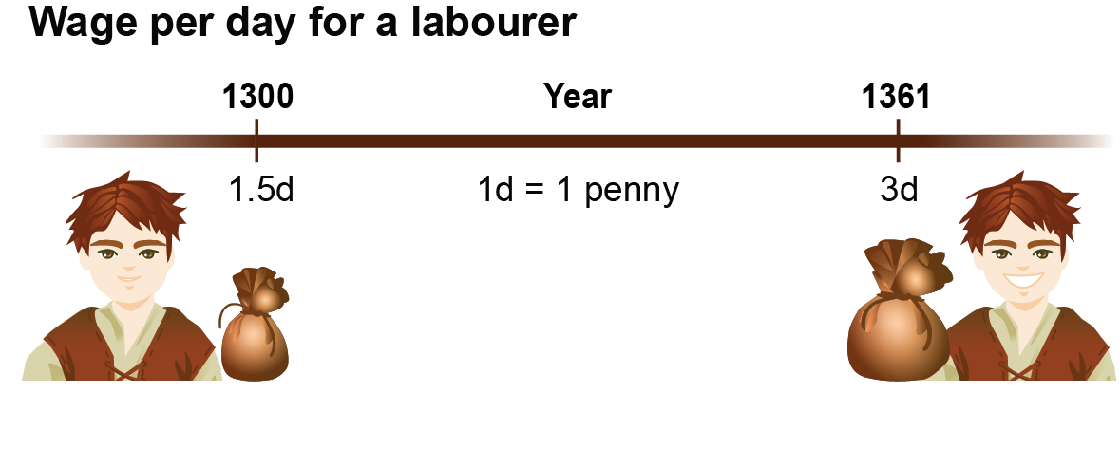
Source F
Source F is drawn from 14th century records of Savarnak House in England, showing the wage per day for a labourer (a peasant who worked on farms or in workshops).
One of the long-term effects of the Black Death was a change in the amount of power peasants had. Because the huge death toll meant a smaller workforce, the remaining peasants were suddenly more important. Nobles were forced to pay them more to ensure the work was done on the farms.
Source F shows how much wages in England had grown just 11 years after the plague first occurred.

Slide 8

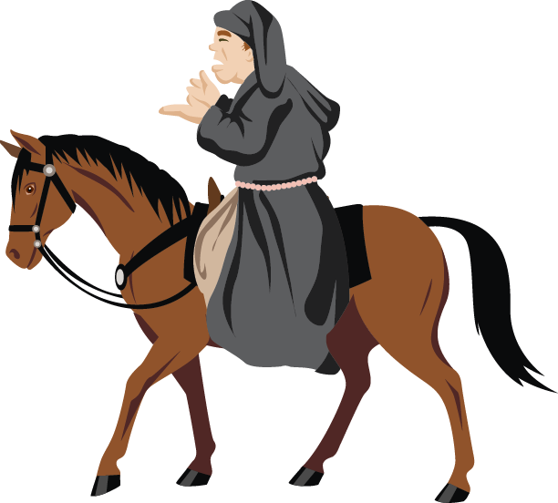
Source G
“Good people, things cannot go right in England and never will, until goods are held in common, and there are no more villeins and gentlefolk, but we are all one and united.
In what way are those we call lords, greater masters than ourselves? If we all spring from a single father and mother, Adam and Eve, how can they claim or prove they are more lords than us?”
Source G is a passage from a speech by John Ball in 1381. Ball was a priest who protested against the way the peasants were treated by the nobles.
Image: www.123rf.com/photo_6751239_really-old-book-isolated-on-white-background.html
He travelled throughout England speaking to peasants about the injustices in society.

Slide 9
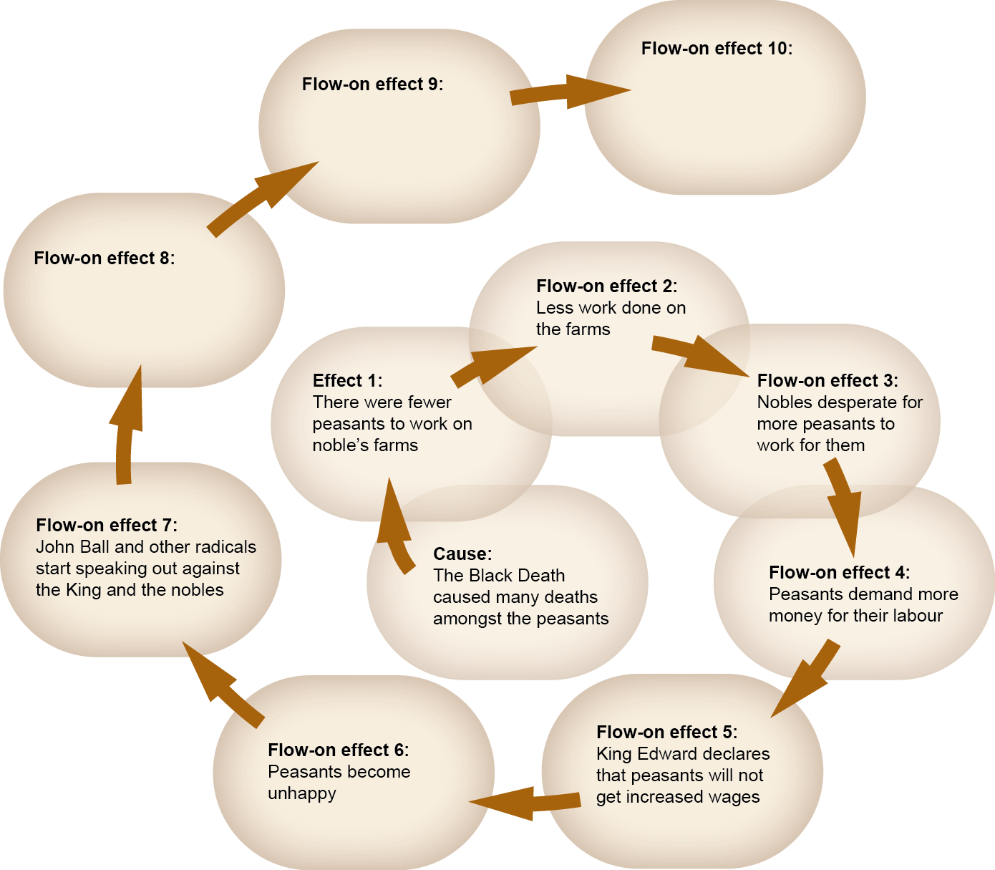
Graphic organiser

Slide 10
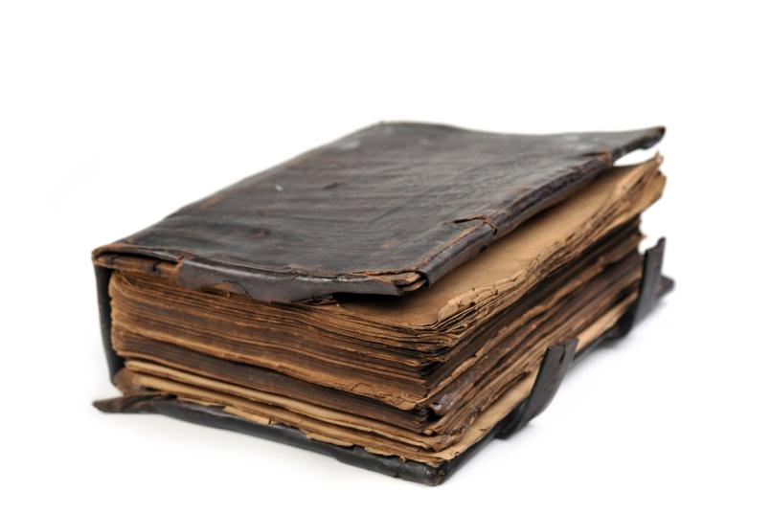
Froissart’s chronicle
All over Europe peasants were becoming increasingly unhappy with the lives that nobles were forcing them to live. In many places, the peasants grew so unhappy that they rebelled against the nobles.
Jean Froissart, who lived in France during the 1300s, wrote a chronicle in which he recorded many events …
Image: www.123rf.com/photo_6751239_really-old-book-isolated-on-white-background.html

Slide 11
Source H
“Men-at-arms of every kind burst out of the gates and ran into the square to attack those evil men [the peasants]. They mowed them down in heaps and slaughtered them like cattle; and they drove all the rest out of the town, for none of the villeins attempted to take up any sort of fighting order … Never did men commit such vile deeds (as those Jacquerie); I could never bring myself to write down what they did to women … God by His grace provided a remedy … The nobles wiped them out wherever they found them, without mercy or pity.”
In Source H Froissart describes what happened when the Jacquerie led a rebellion in 1358. (Jacquerie was the name given to the rebellious peasants.)
Image:Old Paper - Single, bittbox, Creative Commons Attribution 2.0, www.flickr.com/photos/bittbox/2691975784

Slide 12
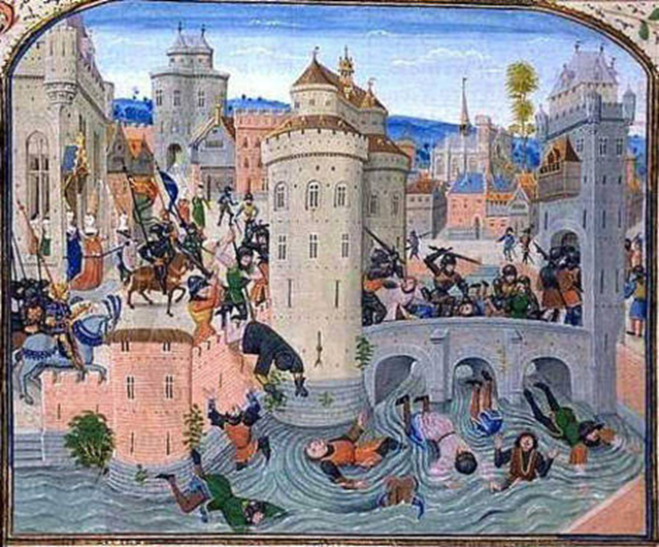
Source I
The image in Source I Defeat at Meaux is an illustration from Froissart’s chronicle of what happened when peasants rebelled in a French town called Meaux.
Image: Defeat at Meaux, artist unknown Public domain image, www.commons.wikimedia.org/wiki/File:Jacquerie_meaux.jpg

